Slide 1

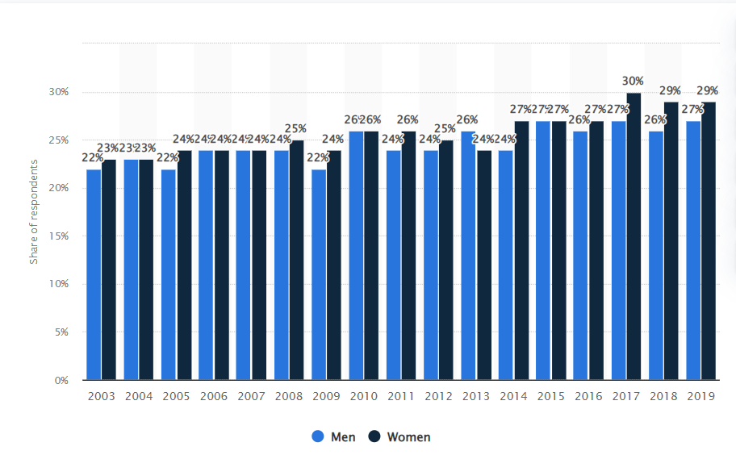
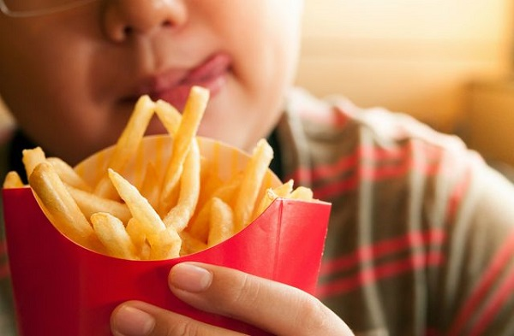
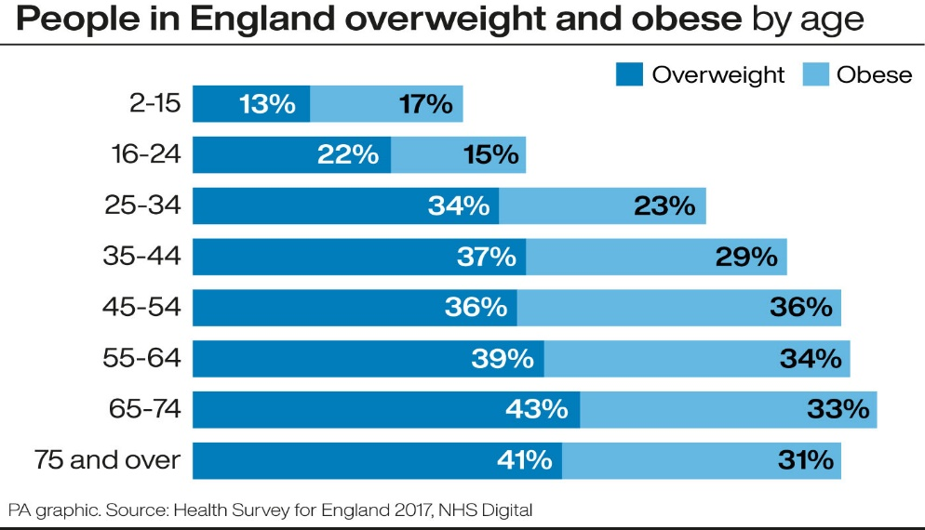
OBESITY IN TEENAGERS: The public health issue
Introduction/rationale of the chosen public health issue in the local area
National and international health care policies
Obesity in teenagers has become a serious health issue in the United Kingdom. It has been researched that more than one-third of teenagers are suffering from obesity. They start their adulthood the excess weight. It is chiefly seen in the poor class families of the UK. According to the study by the Centre for Longitudinal Studies (CLS), about 21% of teenagers were suffering from the disease of obesity at the age of 17 only and about 14% of teenagers were overweight, based on the data collected in 2018-19 (Nikolaou et al., 2020). In the observational study, 28% of poor families’ teenagers are suffering from obesity in comparison to the 14% of rich class teenagers (Ucl. ac, 2022). Hence, it is an urgent need to take immediate action otherwise the teenagers will have to suffer from the long-term health consequences (Tyrer et al., 2019). During the COVID 19 pandemic, the obesity in teenagers rose alarmingly. Thousands of children are facing serious consequences on account of the overweight during the unprecedented crisis. This happened because they started to eat the fast food at their homes more without doing any physical exercise. According to the doctors, obesity increases the risk of type 2 diabetes and heart diseases at an early age.
According to Arthurs et al. (2022), the UK government is highly concerned over the rising crisis of obesity among teenagers. The UK government initiated a new obesity strategy that was published on 27 July 2020. Its purpose is to fight against childhood obesity and motivate adults to manage their lifestyles properly. Therefore, the restaurants, cafes, and takeaways have to mention the calorie of their food and drink products (da Costa Peres et al., 2020). A high regulation has been imposed on the use of too much fat, sugar, and salt. The UK government’s aim is to reduce the gap in obesity between children from the rich and poor classes by 2030, according to the 2018 strategy.
The WHO has taken some serious measures in order to reduce the no. of cases of obesity among teenagers worldwide, and for this, many countries across the world have come together to help the WHO (Gaździńska et al., 2022). According to the issued guidelines of WHO, the countries will improve the environment of teenagers where they live, play, and learn. The government will have to implement those policies that can promote healthy food lifestyles in families. The government will have to provide the necessary prevention and care against the obesity found in teenagers.
Role of nurse in promoting healthcare awareness
The contribution of nurses is no less than the doctors to help teenagers achieve a healthy weight by pursuing a healthy lifestyle (Palla et al., 2020). Therefore, the nurses in the UK hospitals keep their weight healthy. They provide nutritional advice to parents and teenagers. They also tell them about various weight management programs and offer them strategies to decrease the intake of calories (Tinner et al., 2021). Their main emphasis lies in physical exercises so that they will be able to burn their calories. Nurses’ actions always have the perception of the whole family because it is a challenging task for obese teenagers to change their diet plans or physical activities in a day if they are not monitored by their families (Yates et al., 2020). The nurses have to do the work with teenagers and their families by making their team multidisciplinary in order to control the persistent problem of obesity among the teenagers as it is a serious health issue with long-term morbidities. Therefore, it is very essential to control obesity at an early age otherwise teenagers can suffer from other serious health issues i.e. hypertension and metabolic disorders. In their adulthood, they will get problems being employed easily and are always given low salaries.
Figure 1: Obesity in UK
(Source: Statista.com, 2022)
Identification and analysis of the key data
About 11% of boys and 15% of girls between the age of two and ten were classified as overweight in the United Kingdom in 2019 (Waterlander et al., 2020). The government has banned the sales of unhealthy food products as well as beverages in the malls. The restrictions are imposed on the advertisements for fast food and beverages. Teenagers are adopting very low food security in the UK and their share has risen by 3% between 2019 and 2020 (UK et al., 2022). According to Robinson et al. (2021), the impact of coronavirus changed their food habits. They started to eat more snacks and do less physical exercise during the days of lockdown. When the schools were closed, they were shut in the four walls of their homes and didn’t follow a perfect daily routine. They adopted an unhealthy lifestyle by watching TV more and eating nutritious foods less (Singh and Tawfik, 2019). They liked the fast food more and didn’t go for the morning as well as evening walks. Therefore, the cases of obesity have increased among teenagers which will make them seriously ill with their growing age. The government has to take major steps in this regard.
Figure 3: Wrong eating habits and obesity
(Source: Singh and Tawfik, 2019)
A potential area of development
In July 2020, the UK government began the Better Health Campaign to reduce the number of cases of obesity in teenagers on account of the covid -19 pandemic. The government’s approach was to encourage eating habits and an active lifestyle among teenagers. According to the National Health Service, the reduced cases will decrease the pressure on the doctors as well as on the nurses in the NHS (Hamer et al., 2020). The government launches advertisements for foods that are high in fat, sugar, and salt so that the teenagers and their parents will be more aware for their health issues. The restaurants, cafes, and takeaways are labeling the food information on their food items and beverages. Many teenagers are categorized as obese on the basis of their BMI (an imperfect evaluation of adiposity and health risks). According to Robinson, Gillespie and Jones (2020), such teenagers are metabolically healthy and have low risks of serious health issues that are associated with the overweight. But there is so much that needs to be done to persuade teenagers for healthy eating habits. The government’s campaign focuses on the minimal intake of calories by making them choose healthier based on the range of calories. They should take a balanced diet that is full of vegetables and whole grains.
Figure 2: Overweight and obesity in England by age
(Source: Statista.com, 2022)
Reference List
Arthurs, N., Tully, L., O’Malley, G. and Browne, S., (2022). Usability and Engagement Testing of mHealth Apps in Paediatric Obesity: A Narrative Review of Current Literature. International Journal of Environmental Research and Public Health, 19(3), p.1453.
da Costa Peres, C.M., Gardone, D.S., Costa, B.V.D.L., Duarte, C.K., Pessoa, M.C. and Mendes, L.L., (2020). Retail food environment around schools and overweight: a systematic review. Nutrition Reviews, 78(10), pp.841-856.
Gaździńska, A., Jagielski, P., Turczyńska, M., Dziuda, Ł. and Gaździński, S., (2022). Assessment of Risk Factors for Development of Overweight and Obesity among Soldiers of Polish Armed Forces Participating in the National Health Programme 2016–2020. International Journal of Environmental Research and Public Health, 19(5), p.3069.
Hamer, M., Kivimäki, M., Gale, C.R. and Batty, G.D., (2020). Lifestyle risk factors, inflammatory mechanisms, and COVID-19 hospitalization: A community-based cohort study of 387,109 adults in UK. Brain, behavior, and immunity, 87, pp.184-187.
Nikolaou, C.K., Robinson, T.N., Sim, K.A. and Lean, M.E., (2020). Turning the tables on obesity: young people, IT and social movements. Nature Reviews Endocrinology, 16(2), pp.117-122.
Palla, L., Chapman, A., Beh, E., Pot, G. and Almiron-Roig, E., (2020). Where do adolescents eat less-healthy foods? Correspondence analysis and logistic regression results from the UK national diet and nutrition survey. Nutrients, 12(8), p.2235.
Robinson, E., Boyland, E., Chisholm, A., Harrold, J., Maloney, N.G., Marty, L., Mead, B.R., Noonan, R. and Hardman, C.A., (2021). Obesity, eating behavior and physical activity during COVID-19 lockdown: A study of UK adults. Appetite, 156, p.104853.
Robinson, E., Gillespie, S. and Jones, A., (2020). Weight‐related lifestyle behaviours and the COVID‐19 crisis: An online survey study of UK adults during social lockdown. Obesity science & practice, 6(6), pp.735-740.
Singh, B. and Tawfik, H., (2019), June. A machine learning approach for predicting weight gain risks in young adults. In 2019 10th International Conference on Dependable Systems, Services and Technologies (DESSERT) (pp. 231-234). IEEE.
Statista (2022). Obesity prevalence in England 2003-2019 | Available at: https://www.statista.com/statistics/376074/obesity-prevalence-by-gender-in-england-uk/ (Accessed: 12 April 2022).
Tinner, L., Caldwell, D., Hickman, M. and Campbell, R., (2021). Understanding adolescent health risk behaviour and socioeconomic position: A grounded theory study of UK young adults. Sociology of health & illness, 43(2), pp.528-544.
Tyrer, F., Dunkley, A.J., Singh, J., Kristunas, C., Khunti, K., Bhaumik, S., Davies, M.J., Yates, T.E. and Gray, L.J., (2019). Multimorbidity and lifestyle factors among adults with intellectual disabilities: a cross‐sectional analysis of a UK cohort. Journal of Intellectual Disability Research, 63(3), pp.255-265.
Ucl.ac (2022). Poorer teens at substantially greater risk of obesity (2020). Available at: https://www.ucl.ac.uk/news/2020/dec/poorer-teens-substantially-greater-risk-obesity (Accessed: 12 April 2022).
UK, D. et al. (2022) Diabetes UK - Know diabetes. Fight diabetes. | Diabetes UK, Diabetes.org.uk. Available at: https://www.diabetes.org.uk/ (Accessed: 12 April 2022).
Waterlander, W.E., Luna Pinzon, A., Verhoeff, A., Den Hertog, K., Altenburg, T., Dijkstra, C., Halberstadt, J., Hermans, R., Renders, C., Seidell, J. and Singh, A., (2020). A system dynamics and participatory action research approach to promote healthy living and a healthy weight among 10–14-year-old adolescents in Amsterdam: The LIKE programme. International journal of environmental research and public health, 17(14), p.4928.
Yates, T., Razieh, C., Zaccardi, F., Davies, M.J. and Khunti, K., (2020). Obesity and risk of COVID-19: analysis of UK biobank. Primary care diabetes, 14(5), p.566.

